Slide 1




Smart Warehousing:
Intelligence-Driven, Data-Enabled
RBCC Team 9：Jiaxuan Li、Jie Li、 Bolun Zhang、Jiahong He、Pengcheng Shen:

Slide 2


Contents
01
02
Corporate Research
Technical Analysis
PART ONE
PART TWO
03
04
Product Overview
Business Analysis
PART THREE
PART FOUR
05
06
Vision and Strategic
Team Introduction
PART FIVE
PART SIX
2

Slide 3


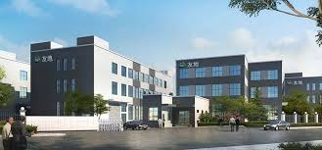

Company Profile
01
Youdi Metal Processing Park
Industry Focus：Covers over 80% of core metal component manufacturing needs in the region.
Enterprise Cluster：Home to 50+ SMEs (small and medium-sized enterprises) engaged in precision metal parts production.
Zhejiang Zhuji Haiao Hydraulic Machinery Co., Ltd.
Climate Change: Melting glaciers, rising seas, and rampant disasters devastate ecosystems and health.
Core Business: Manufacturing of hydraulic fittings and fluid connection parts.
Business Type: Mainly non-standard part processing (ratio 1:9).
Operating Model: Supermarket-style warehousing and sales.
3
Corporate Research | Technical Analysis | Product Overview | Business Analysis | Vision and Strategic | Team Introduction

Slide 4
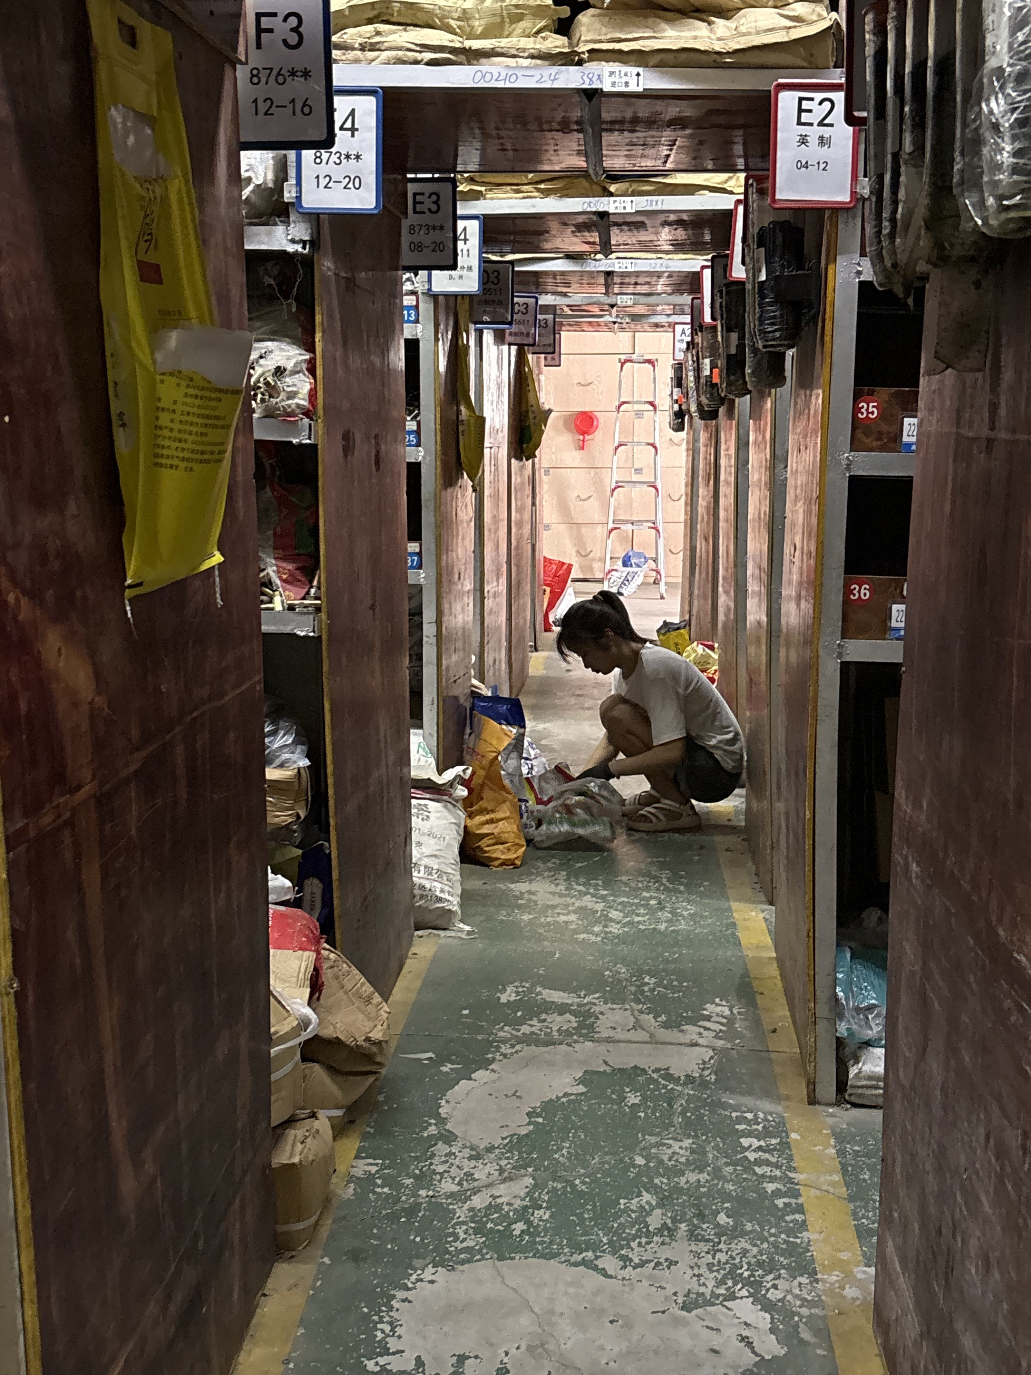
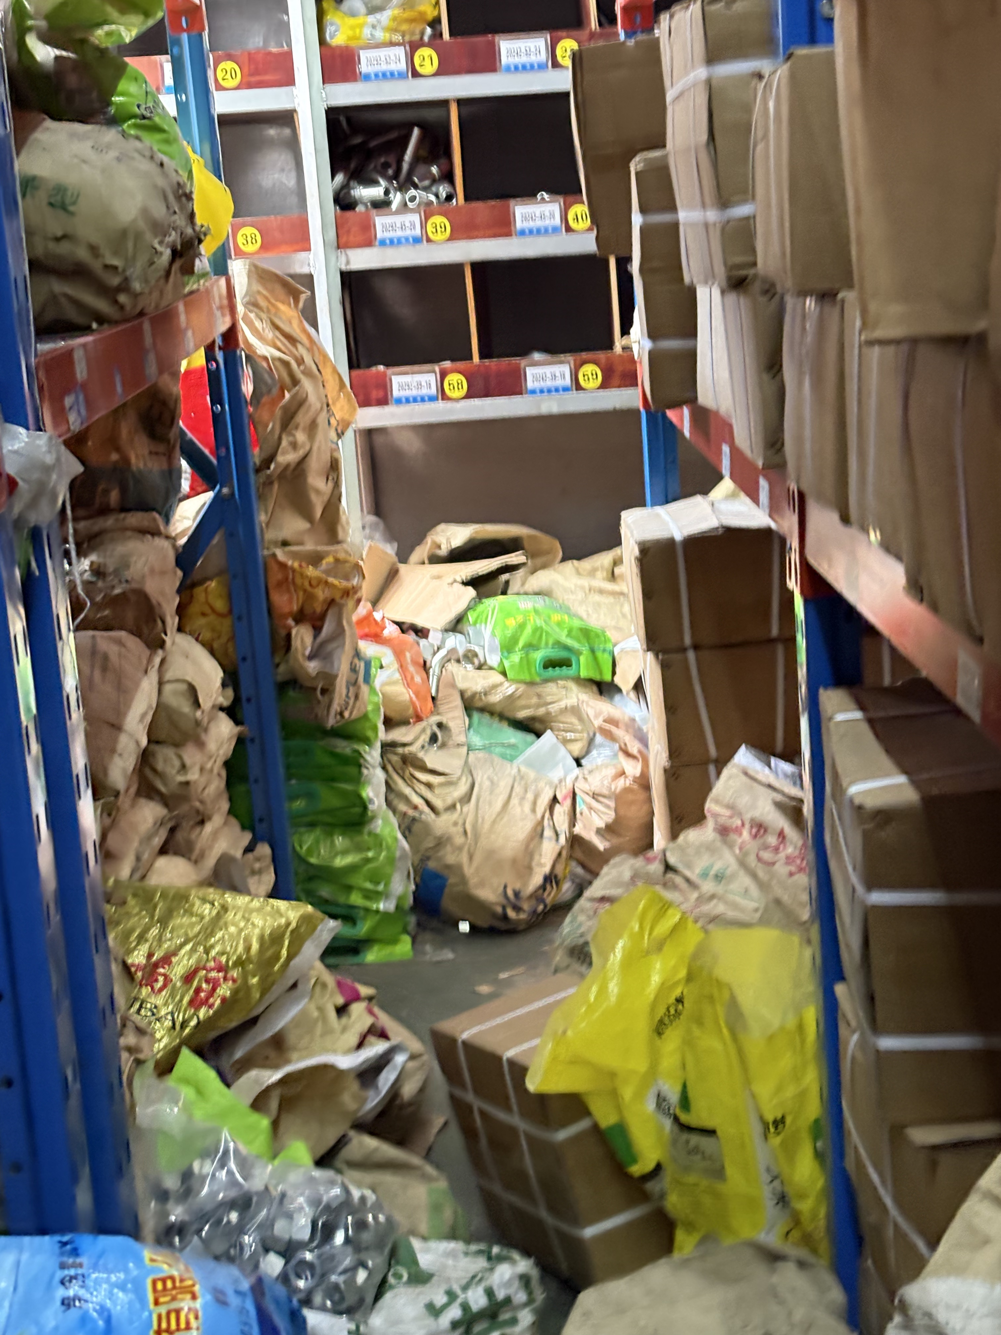
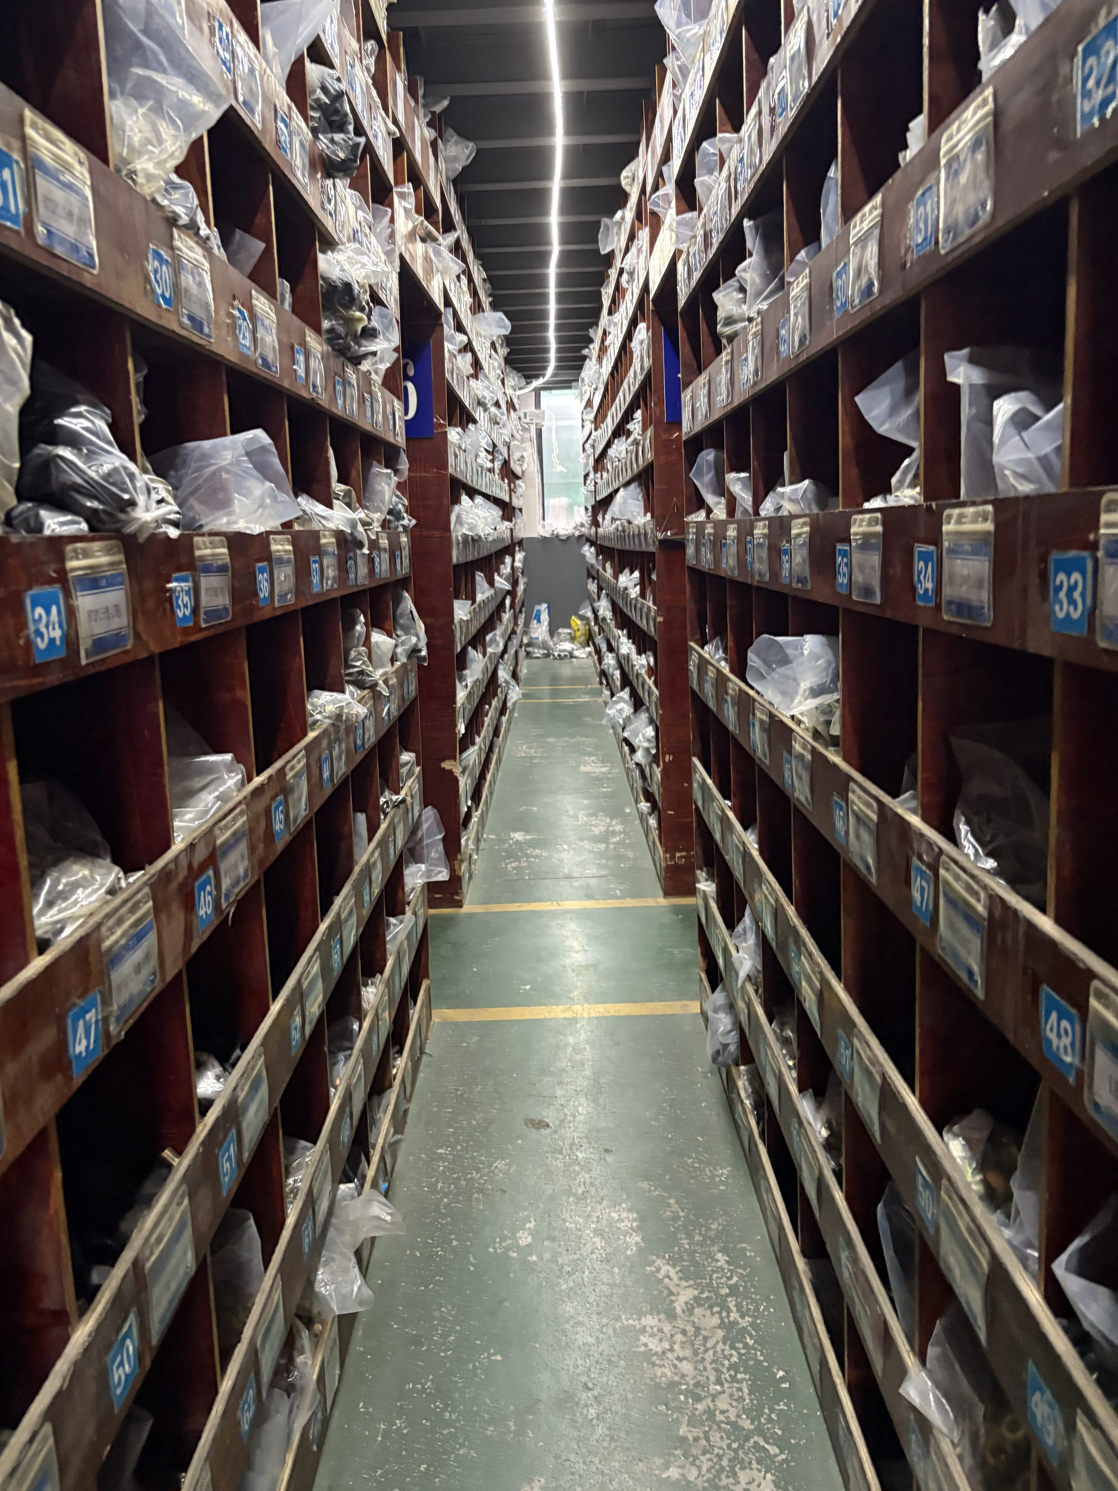
Research Background
High labor costs in warehouse logistics
Disorganized storage environment
Lack of Sales Forecasting
→ Inventory Overload
.
4
Corporate Research | Technical Analysis | Product Overview | Business Analysis | Vision and Strategic | Team Introduction

Slide 5
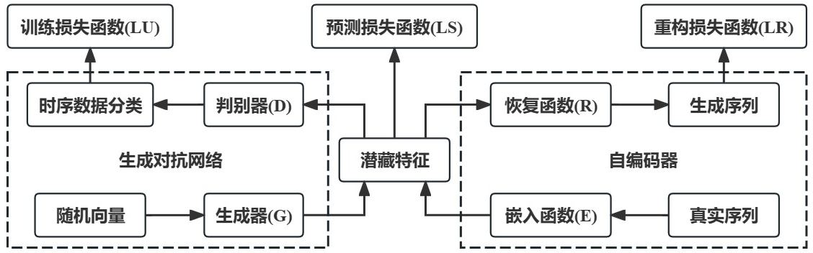
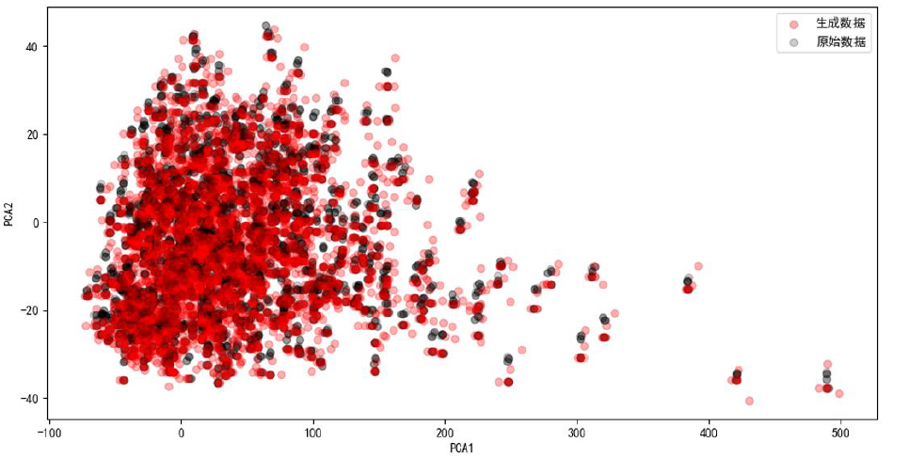
Technical Analysis
01
基于 TimeGAN-GA-LSTM 的金属零件销量预测模型
TimeGAN（时间生成对抗网络）增强数据 利用TimeGAN对原始销量数据进行增强，有效缓解小样本问题，提升模型的泛化能力。
训练损失函数
重构损失函数
预测损失函数
TimeGAN 包括四个核心模块：
生成器 G：生成仿真时间序列数据。
判别器 D：区分真实和合成数据。
嵌入函数 E ：提取与重建时间特征。
恢复函数 R：提取与重建时间特征。
应用效果：
生成具有时间依赖特性的合成销量数据。
显著提升训练集的多样性与模型的泛化能力。
5
Corporate Research | Technical Analysis | Product Overview | Business Analysis | Vision and Strategic | Team Introduction

Slide 6
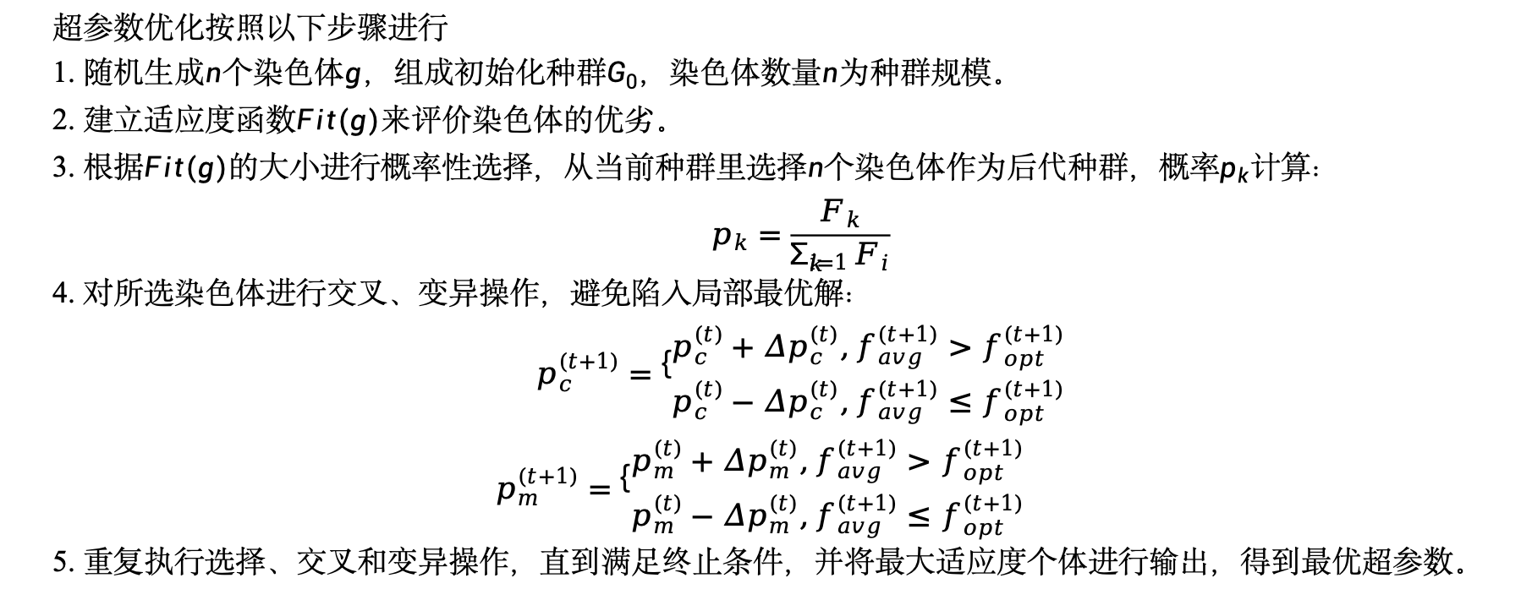
Technical Analysis
01
基于 TimeGAN-GA-LSTM 的金属零件销量预测模型
GA（遗传算法）优化超参数 引入GA优化LSTM模型的隐藏层节点数、学习率、训练轮数等超参数，提升模型拟合能力，避免过拟合。
超参数优化按照以下步骤进行
1. 随机生成$n$个染色体$g$，组成初始化种群$G_{0}$，染色体数量$n$为种群规模。
2. 建立适应度函数$Fit(g)$来评价染色体的优劣。
3. 根据$Fit(g)$的大小进行概率性选择，从当前种群里选择$n$个染色体作为后代种群，概率$p_{k}$计算：
$$p_{k}=\frac{F_{k}}{\sum_{i=1}^{k}{F_{i}}}$$
4. 对所选染色体进行交叉、变异操作，避免陷入局部最优解：
$$p_{c}^{(t+1)}=\left\{\begin{aligned}&p_{c}^{(t)}+Δp_{c}^{(t)},f_{avg}^{(t+1)}>f_{opt}^{(t+1)} \\ &p_{c}^{(t)}−Δp_{c}^{(t)},f_{avg}^{(t+1)}≤f_{opt}^{(t+1)}\end{aligned}\right. \\ p_{m}^{(t+1)}=\left\{\begin{aligned}&p_{m}^{(t)}+Δp_{m}^{(t)},f_{avg}^{(t+1)}>f_{opt}^{(t+1)} \\ &p_{m}^{(t)}−Δp_{m}^{(t)},f_{avg}^{(t+1)}≤f_{opt}^{(t+1)}\end{aligned}\right.$$
5. 重复执行选择、交叉和变异操作，直到满足终止条件，并将最大适应度个体进行输出，得到最优超参数。
6
Corporate Research | Technical Analysis | Product Overview | Business Analysis | Vision and Strategic | Team Introduction

Slide 7
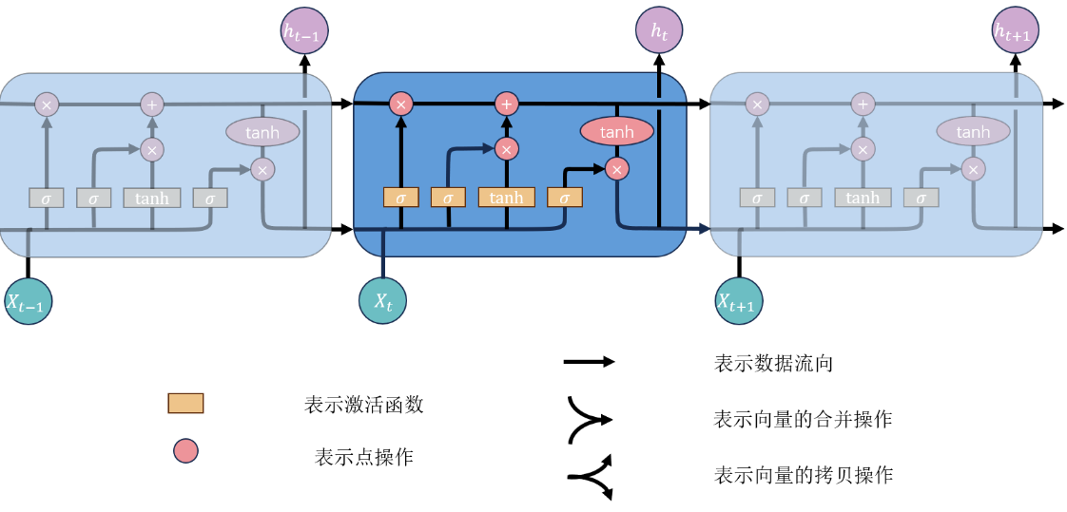

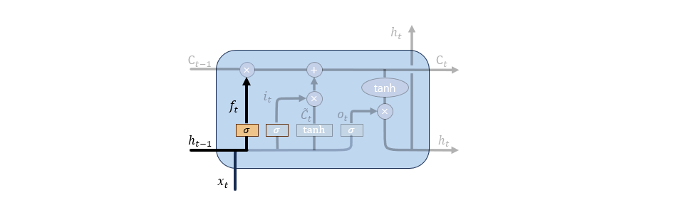
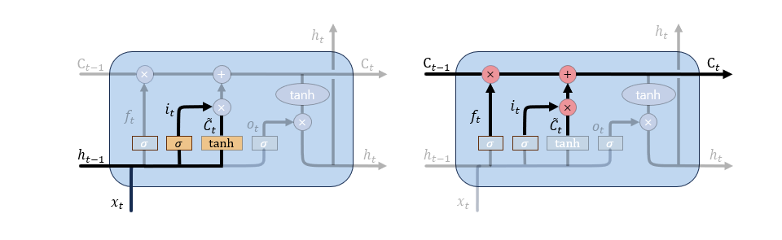



Technical Analysis
01
基于 TimeGAN-GA-LSTM 的金属零件销量预测模型
LSTM（长短期记忆网络） 用于学习金属零件销量的时间序列特征，适用于长期依赖建模，提升基础预测能力。
LSTM模型结构示意图
$$i_{t}=σ\left(W_{i}\left[x_{t},h_{t−1}\right]+b_{i}\right)$$
$${\tilde{C}}_{t}=\tanh\left(W_{c}\left[x_{t},h_{t−1}\right]+b_{c}\right)$$
$$C_{t}=f_{t}C_{t−1}+i_{t}{\tilde{C}}_{t}$$
$$O_{t}=σ\left(W_{o}\left[x_{t},h_{t−1}\right]+b_{o}\right)$$
$h_{t}=O_{t}\tanh\left(C_{t}\right)$
$$f_{t}=σ\left(W_{f}\left[x_{t} , h_{t−1}\right]+b_{f}\right)$$
7
Corporate Research | Technical Analysis | Product Overview | Business Analysis | Vision and Strategic | Team Introduction

Slide 8
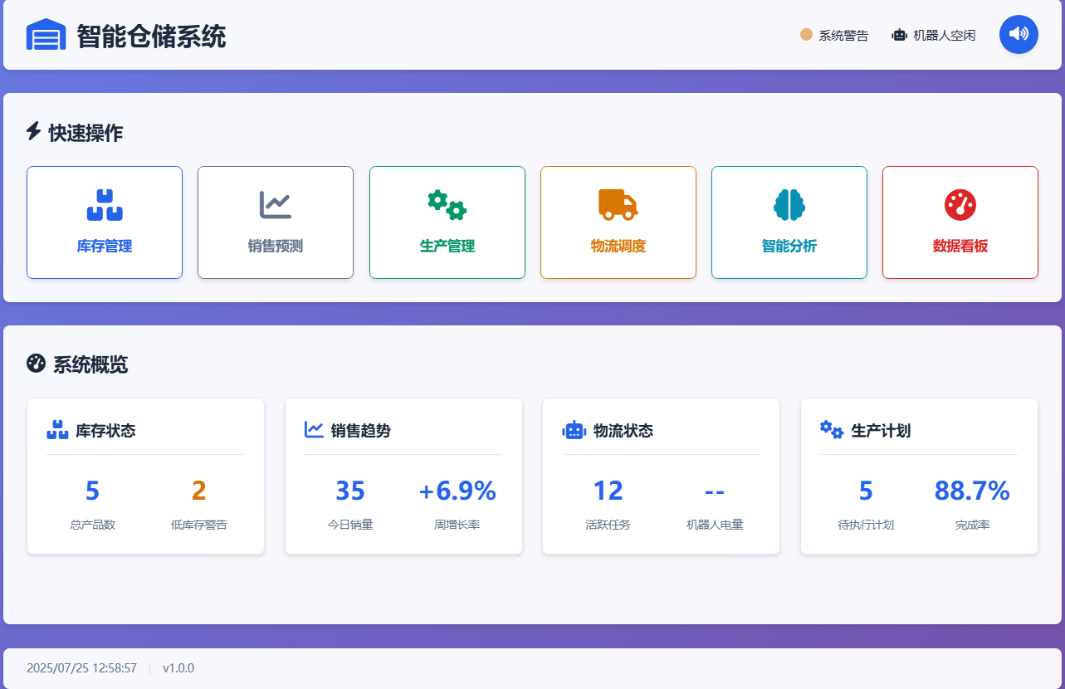
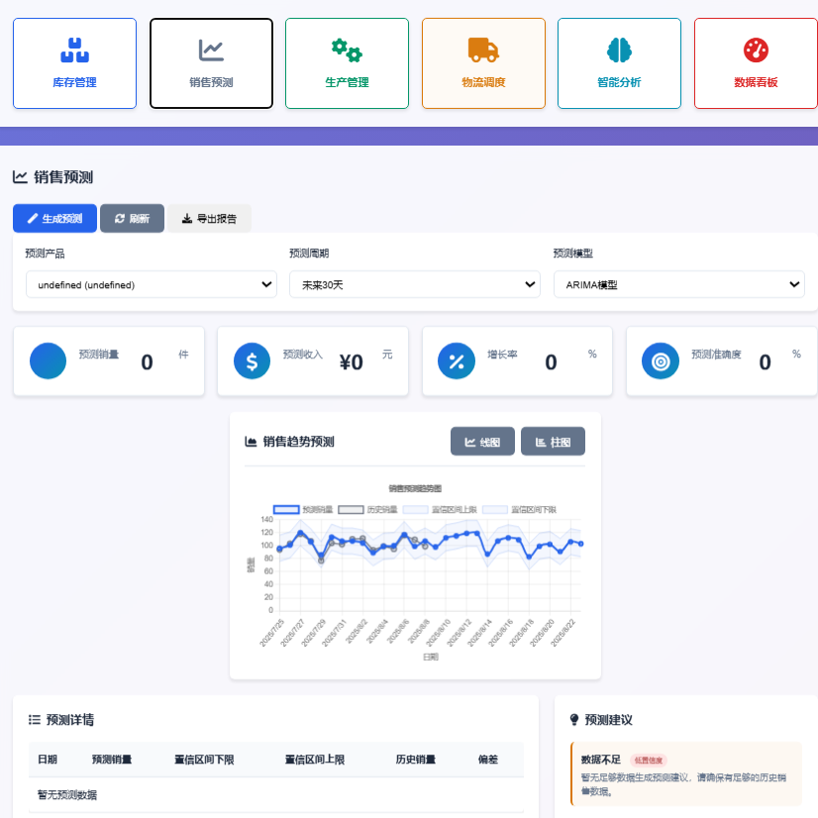
Product Overview
01
Climate Change: Melting glaciers, rising seas, and rampant disasters devastate ecosystems and health.
8
Corporate Research | Technical Analysis | Product Overview | Business Analysis | Vision and Strategic | Team Introduction

Slide 9
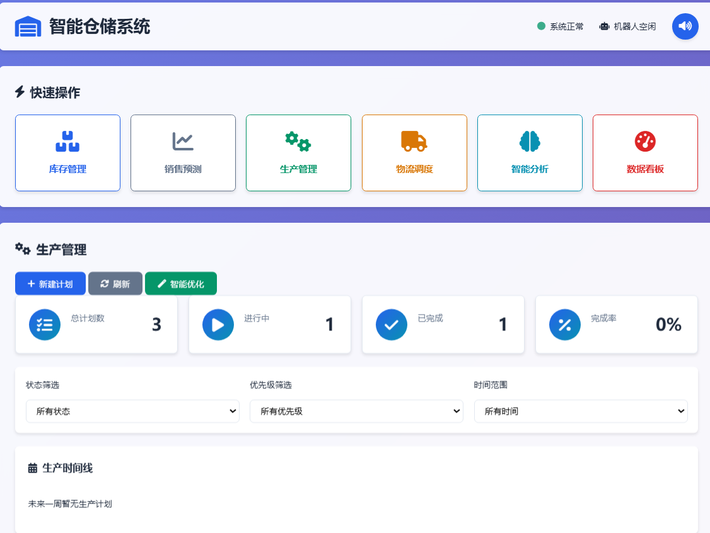
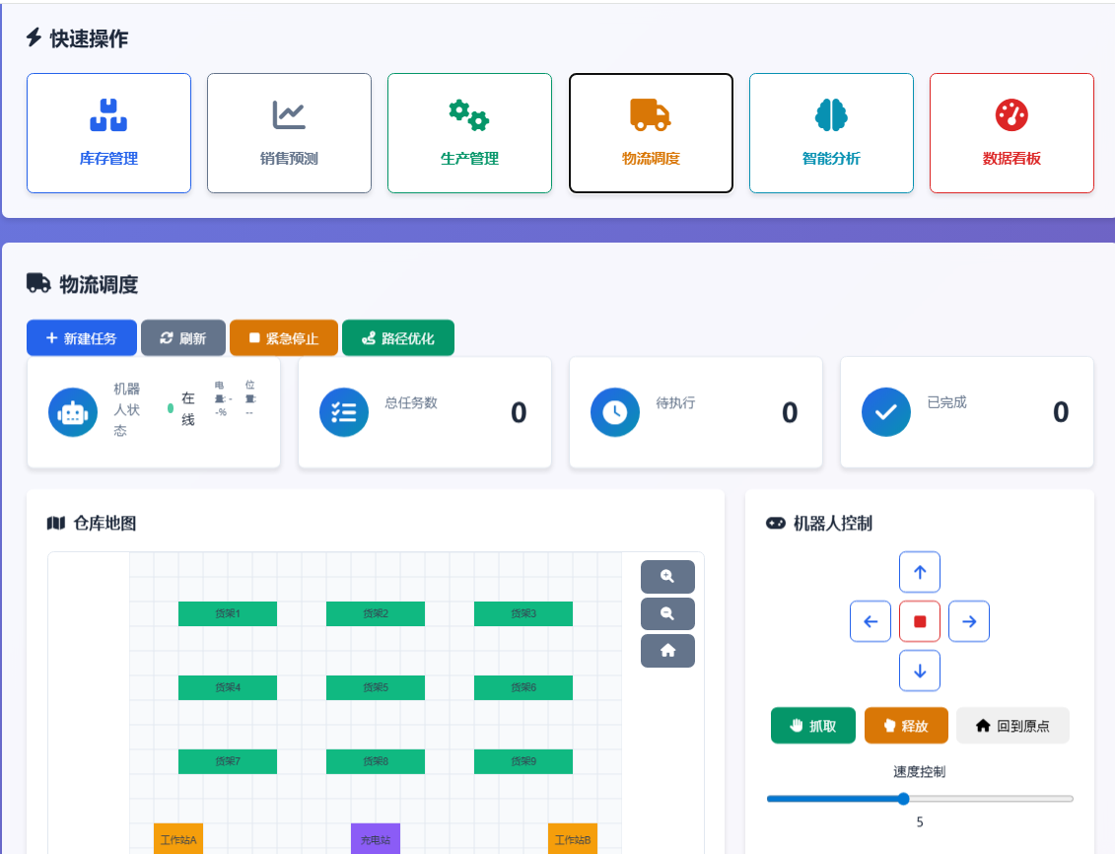
Product Overview
01
Climate Change: Melting glaciers, rising seas, and rampant disasters devastate ecosystems and health.
9
Corporate Research | Technical Analysis | Product Overview | Business Analysis | Vision and Strategic | Team Introduction

Slide 10
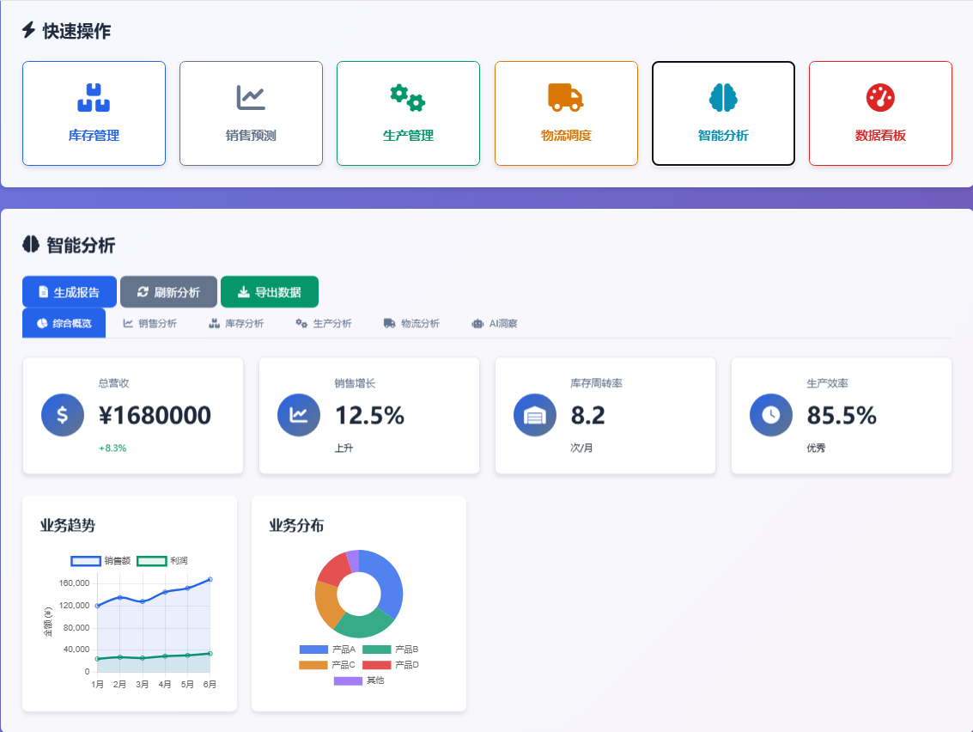
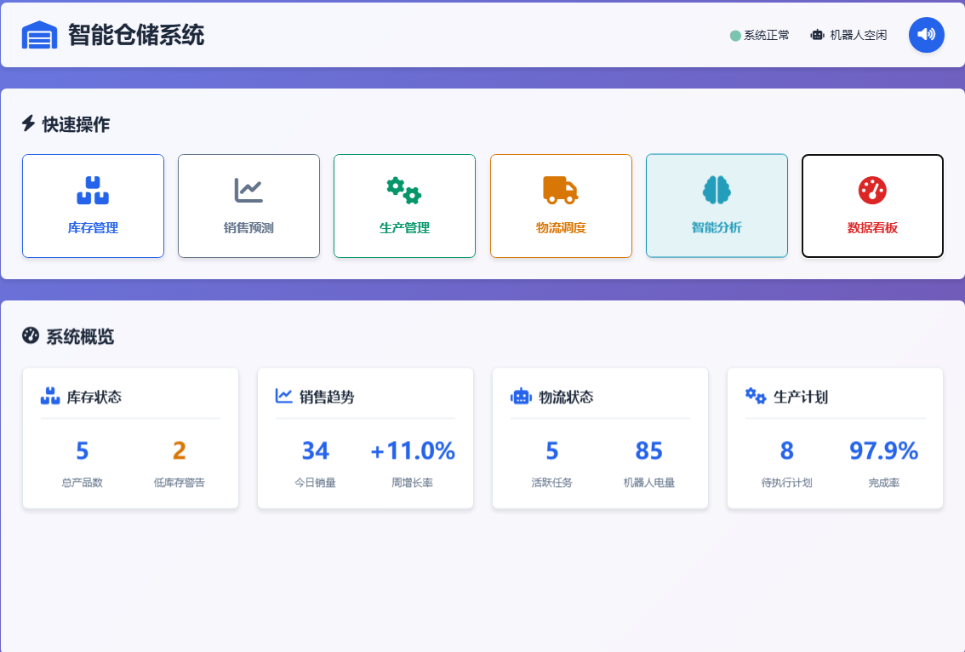
Product Overview
01
Climate Change: Melting glaciers, rising seas, and rampant disasters devastate ecosystems and health.
10
Corporate Research | Technical Analysis | Product Overview | Business Analysis | Vision and Strategic | Team Introduction

Slide 11
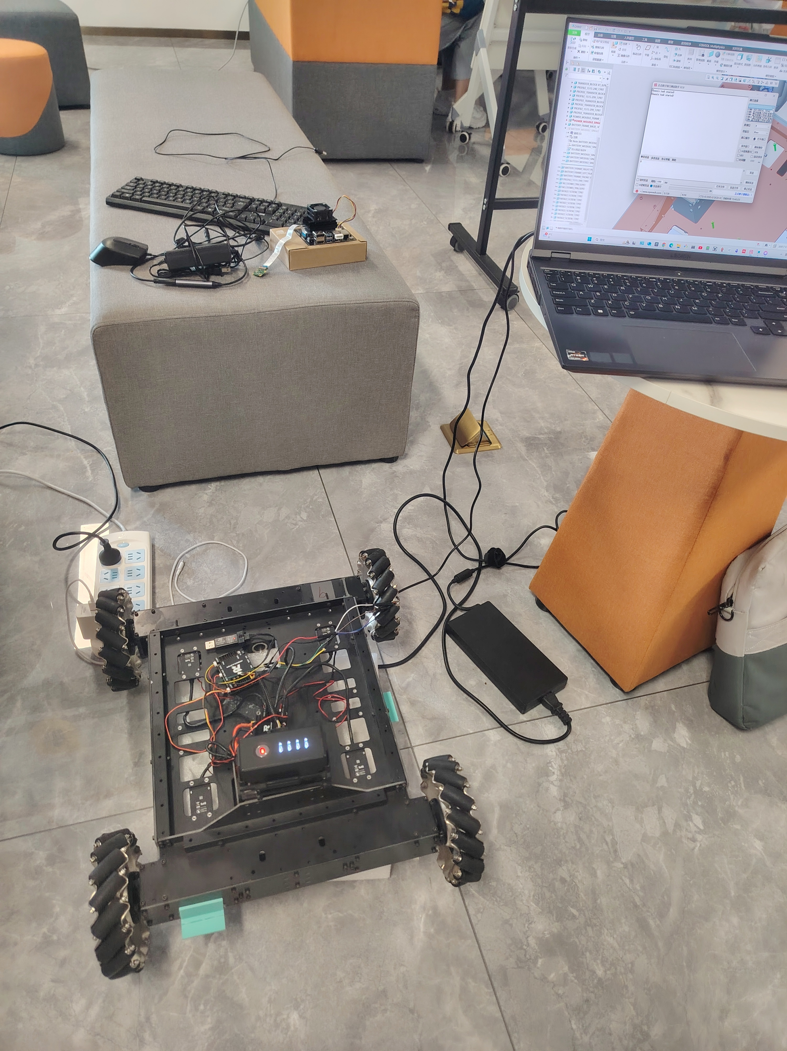
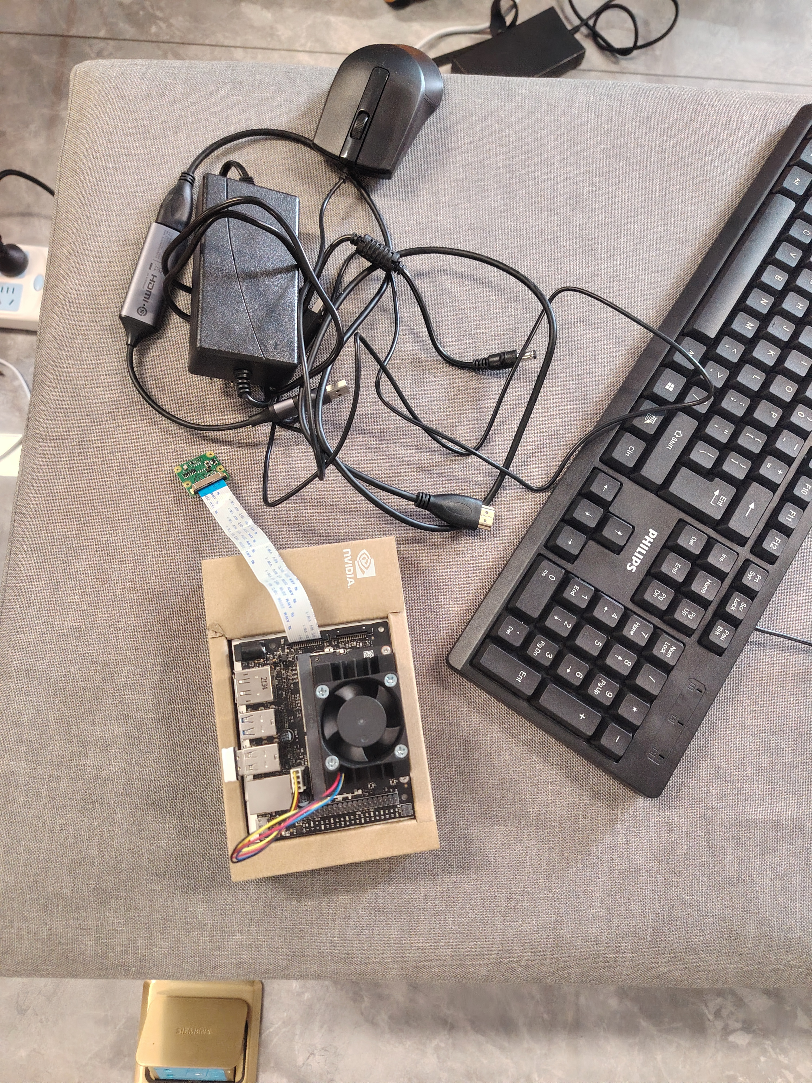
Product Overview
01
Climate Change: Melting glaciers, rising seas, and rampant disasters devastate ecosystems and health.
11
Corporate Research | Technical Analysis | Product Overview | Business Analysis | Vision and Strategic | Team Introduction

Slide 12
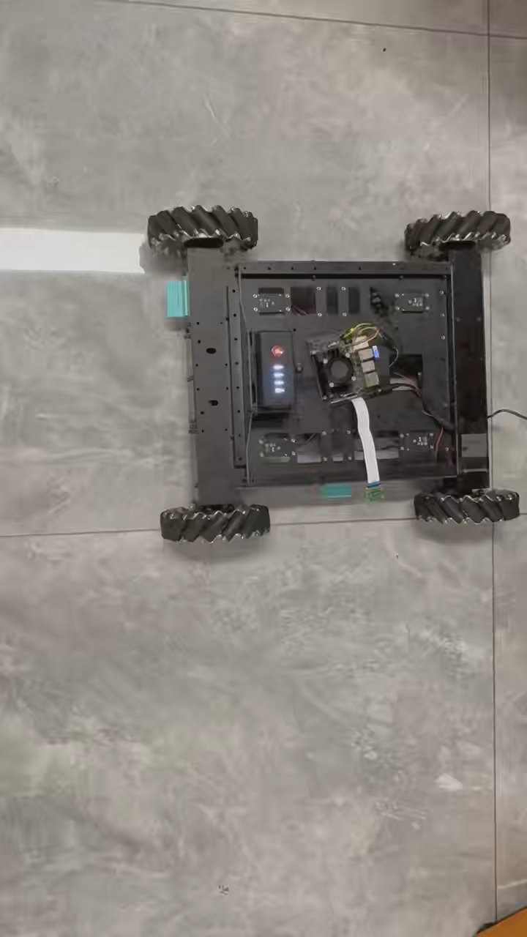
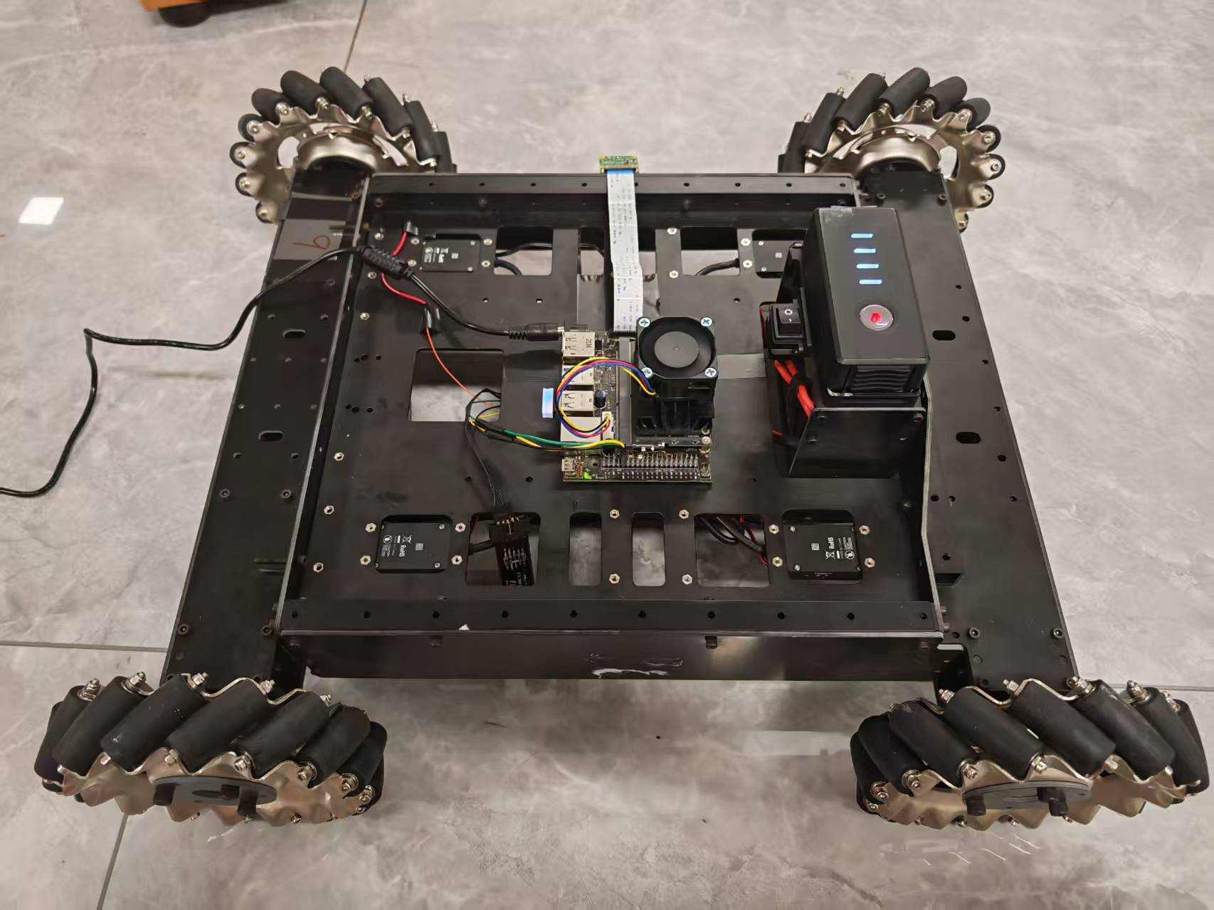
Product Overview
01
Climate Change: Melting glaciers, rising seas, and rampant disasters devastate ecosystems and health.
11
Corporate Research | Technical Analysis | Product Overview | Business Analysis | Vision and Strategic | Team Introduction

Slide 13
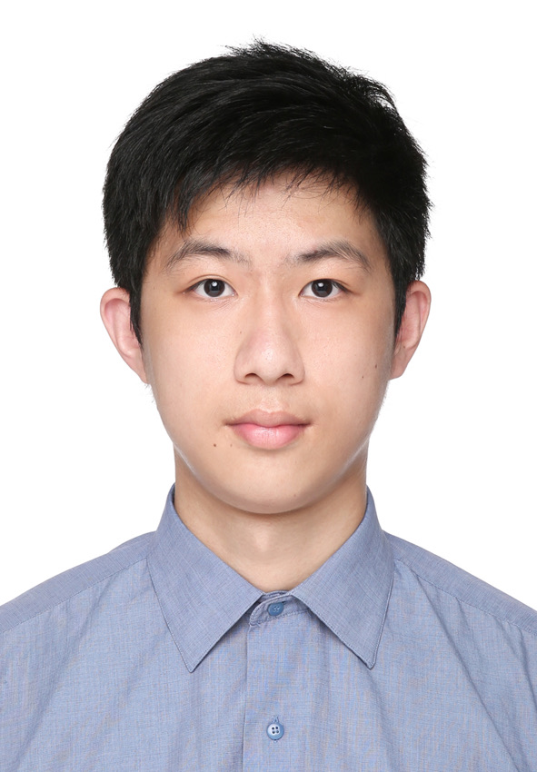
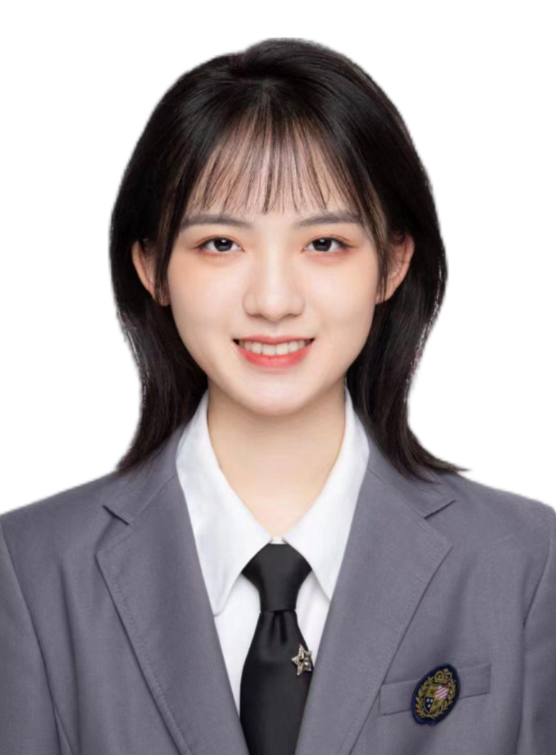
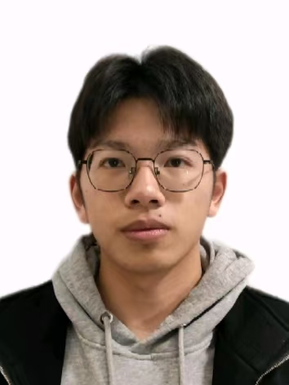

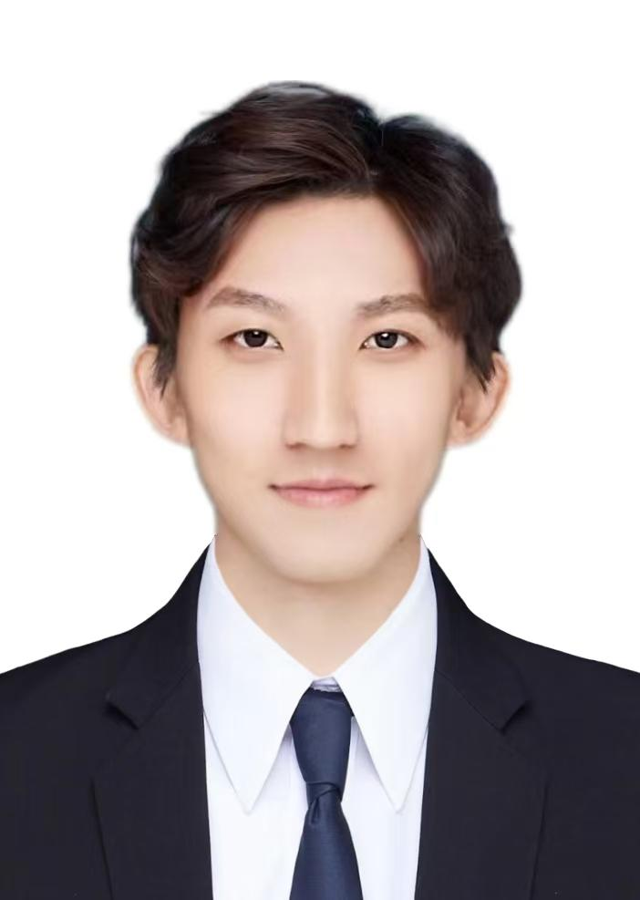
Team Introduction
01
Name: Jiahong He
Major: Business
Role: Business analysis and PPT design
Name：Li Jie
Major: Robotics Engineering
Role: Vehicle hardware and control
Name: Pengcheng Shen
Major: Mathematics
Role: Algorithm design
Climate Change: Melting glaciers, rising seas, and rampant disasters devastate ecosystems and health.
Name: Jiaxuan Li
Major: Electronic Information Engineering
Role: System development and forecasting algorithm design
Name: Bolun Zhang
Major: Intelligent Perception Engineering
Role: visual algorithms and auxiliary hardware debugging
12
Business Analysis | Vision and Strategic
Corporate Research | Technical Analysis | Product Overview | Business Analysis | Vision and Strategic | Team Introduction

Slide 14

THANKS!
Team 9：Jiaxuan Li、Jie Li、 Bolun Zhang、Jiahong He、Pengcheng Shen:

